Slide 1

Introduction to Robotics ME 639: Industrial Project Presentation 2
Project Title: Joint Impedance Control
Team Name: The Usual Suspects
Team Members: Jaydeep Ramnani | Navneet Kaur | Srujan Pandya
Instructor: Prof. Harish PM
Teaching Assistant: Suraj Borate

Slide 2
Problem Statement:
“Joint Impedance Control for an Existing Exoskeleton Incorporating Patient Interaction/Effort.”
Industry name: Timetooth
Objectives:
Model a 1-DOF Knee Joint-Shank Link rotational system
Incorporating Patient Interaction\Effort
Using Impedance Control Method
Determining motor torque for zero patient effort
Back calculate/estimate patient effort along temporal axis
1

Slide 3
Rationale / Approach / Ideas:
The exoskeleton is assumed to be a single link, 1-DOF system. A motor is attached to move the exoskeleton and the patient’s limb.
The project is divided into two steps:
Step 1 – the patient is able to apply the required effort to move the limb along the required trajectory. Thus, the motor has to compensate the mass of the exoskeleton and move only the exoskeleton along the required trajectory. The torque applied by the patient is calculated with the help of the trajectory provided.
Step 2 – the patient is incapable of applying the required effort to follow the trajectory. The motor will have to provide a torque that will move both the patient’s limb as well as the exoskeleton
2

Slide 4
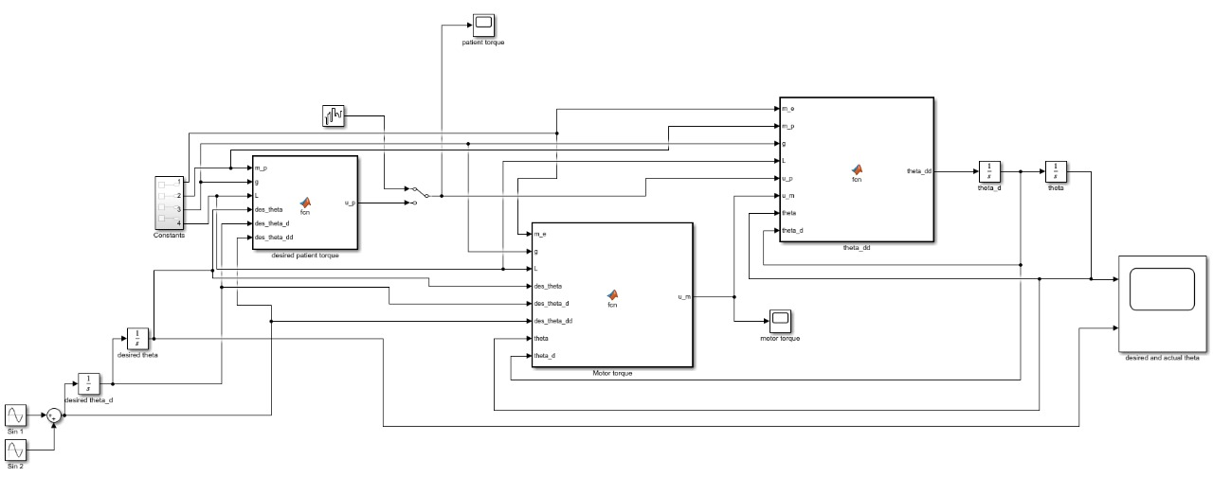
SIMULINK MODEL
3

Slide 5
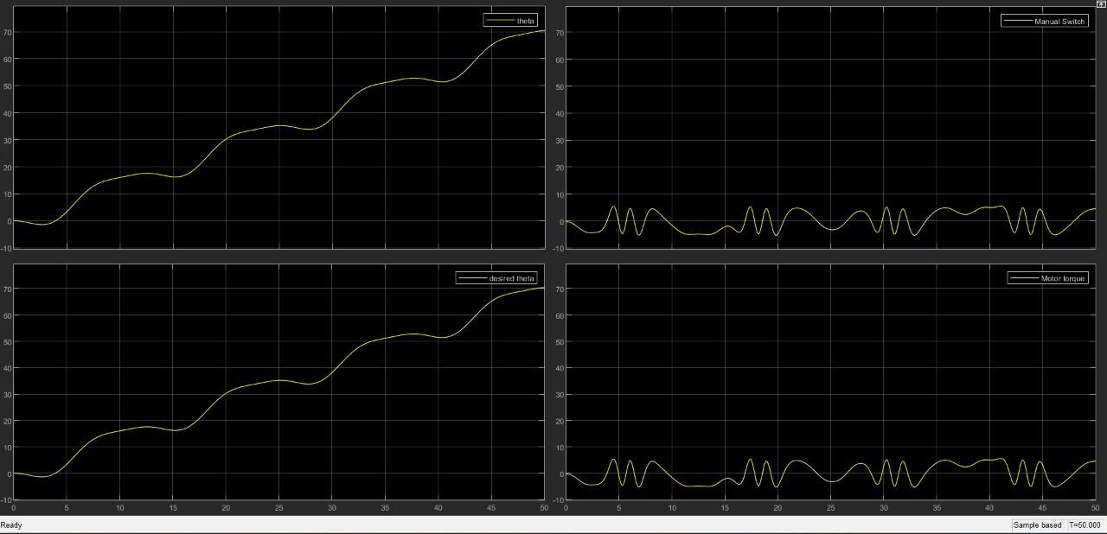
Key Results 1: When the Patient Applies the Desired Patient Torque
Step-1 Results:
The overall system
follows the desired trajectory and the corresponding patient torque and motor torque are measured.
Here, since it is assumed that there is enough effort provided by the patient, the desired patient torque and the applied patient torque are the same.
4

Slide 6
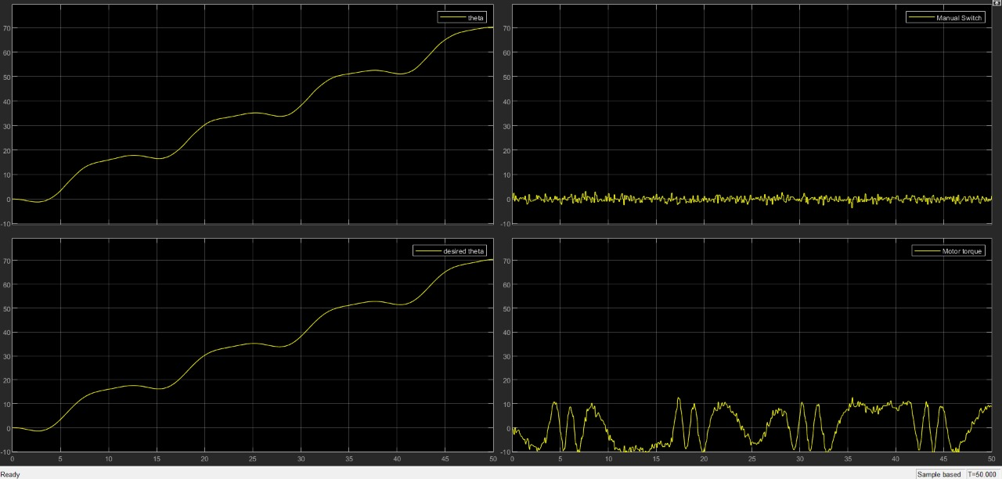
Key Results 2: Results When a Disturbance (Noise) is Provided
Step-2 Results:
The system follows the trajectory even when there is a random disturbance (from the patient’s efforts) instead of a known (desired) patient torque.
The control parameters are unchanged and the controller is able to control the system even in this case.
5

Slide 7
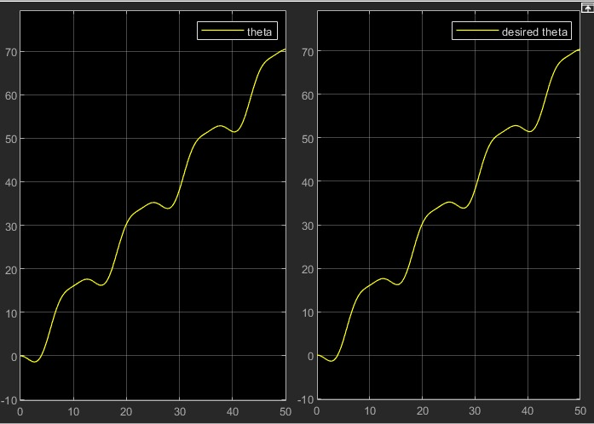
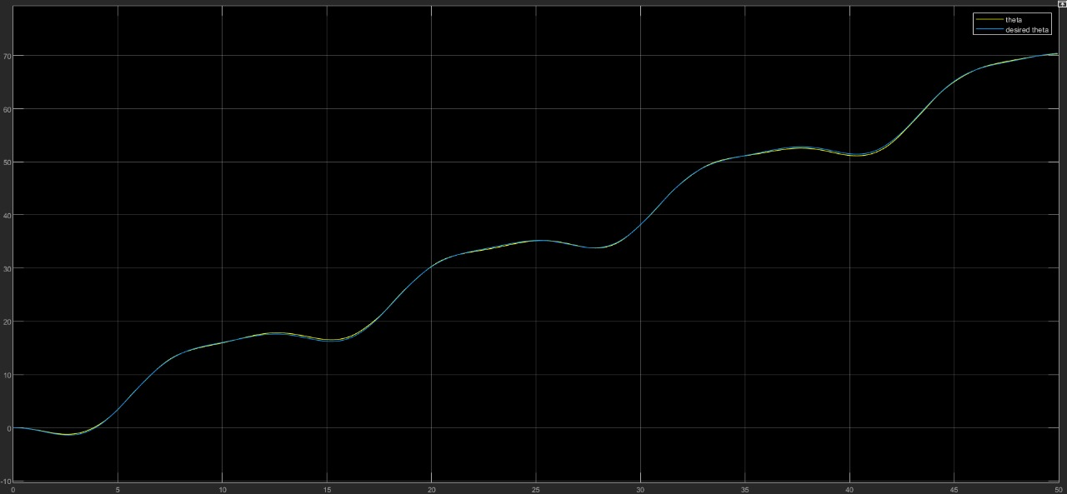

Key Results 3: Desired vs Actual $θ−Profile$ Comparison for the Two Cases
Case 1: Patient effort is sufficient to follow the trajectory
Case 2: A random noise is added as a disturbance to the system
6

Slide 8
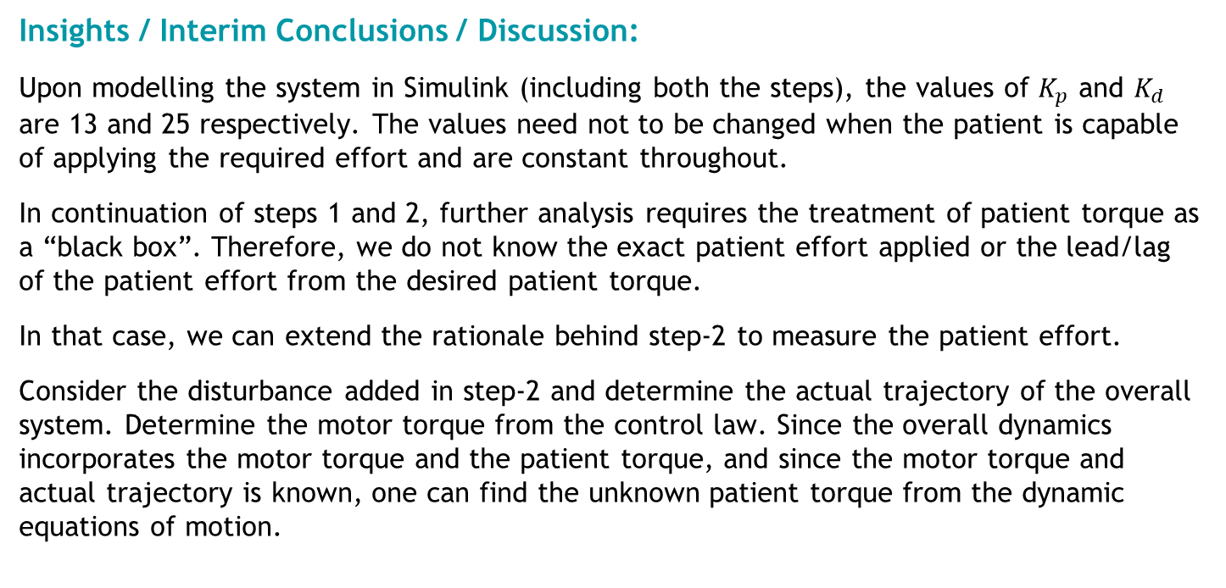
Insights / Interim Conclusions / Discussion:
Upon modelling the system in Simulink (including both the steps), the values of $K_{p}$ and $K_{d}$ are 13 and 25 respectively. The values need not to be changed when the patient is capable of applying the required effort and are constant throughout.
In continuation of steps 1 and 2, further analysis requires the treatment of patient torque as a “black box”. Therefore, we do not know the exact patient effort applied or the lead/lag of the patient effort from the desired patient torque.
In that case, we can extend the rationale behind step-2 to measure the patient effort.
Consider the disturbance added in step-2 and determine the actual trajectory of the overall system. Determine the motor torque from the control law. Since the overall dynamics incorporates the motor torque and the patient torque, and since the motor torque and actual trajectory is known, one can find the unknown patient torque from the dynamic equations of motion.
7

Slide 9

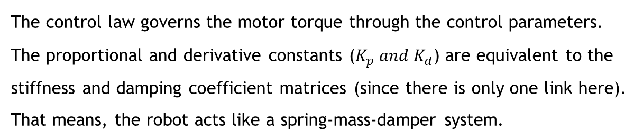
APPENDIX:
Control Law: $τ=K\left(q_{d}−q\right)+D\left(\dot{q_{d}}−\dot{q}\right)+M\left(q\right)\ddot{q_{d}}+C\left(q,\dot{q}\right)+g(q)$
Where,
$$M\left(q\right)=Inertia Matrix$$
$$C\left(q,\dot{q}\right)=Coriolis Terms \\ g\left(q\right)=\frac{mgl}{2}\sin\left(q\right) \\ K=Stiffness Coefficient Matrix \\ D=Damping Coefficient Matrix$$
The control law governs the motor torque through the control parameters. The proportional and derivative constants ($K_{p} and K_{d}$) are equivalent to the stiffness and damping coefficient matrices (since there is only one link here). That means, the robot acts like a spring-mass-damper system.
8

Slide 10
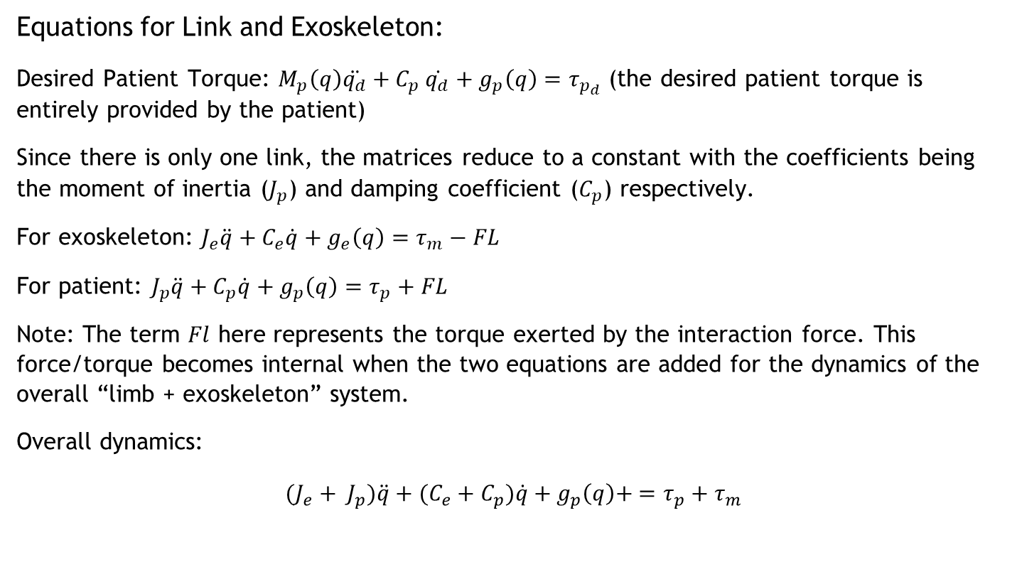
Equations for Link and Exoskeleton:
Desired Patient Torque: $M_{p}\left(q\right)\ddot{q_{d}}+C_{p} \dot{q_{d}}+g_{p}\left(q\right)=τ_{p_{d}}$ (the desired patient torque is entirely provided by the patient)
Since there is only one link, the matrices reduce to a constant with the coefficients being the moment of inertia ($J_{p}$) and damping coefficient ($C_{p}$) respectively.
For exoskeleton: $J_{e}\ddot{q}+C_{e}\dot{q}+g_{e}\left(q\right)=τ_{m}−FL$
For patient: $J_{p}\ddot{q}+C_{p}\dot{q}+g_{p}\left(q\right)=τ_{p}+FL$
Note: The term $Fl$ here represents the torque exerted by the interaction force. This force/torque becomes internal when the two equations are added for the dynamics of the overall “limb + exoskeleton” system.
Overall dynamics:
$${(J_{e}+ J}_{p})\ddot{q}+{(C_{e}+C}_{p})\dot{q}+g_{p}\left(q\right)+ =τ_{p}+τ_{m}$$
9

Slide 11
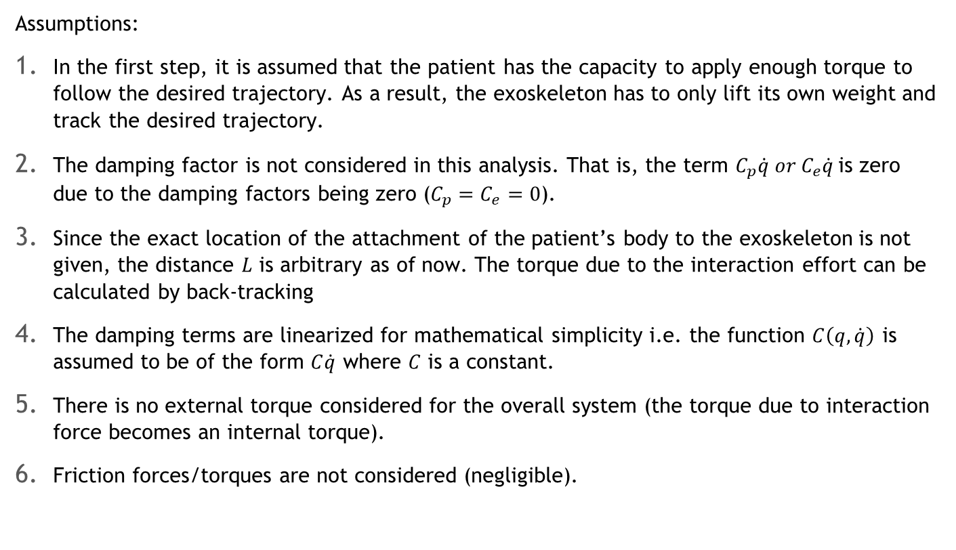
Assumptions:
In the first step, it is assumed that the patient has the capacity to apply enough torque to follow the desired trajectory. As a result, the exoskeleton has to only lift its own weight and track the desired trajectory.
The damping factor is not considered in this analysis. That is, the term $C_{p}\dot{q} or C_{e}\dot{q}$is zero due to the damping factors being zero ($C_{p}=C_{e}=0$).
Since the exact location of the attachment of the patient’s body to the exoskeleton is not given, the distance $L$ is arbitrary as of now. The torque due to the interaction effort can be calculated by back-tracking
The damping terms are linearized for mathematical simplicity i.e. the function $C\left(q,\dot{q}\right)$ is assumed to be of the form $C\dot{q}$ where $C$ is a constant.
There is no external torque considered for the overall system (the torque due to interaction force becomes an internal torque).
Friction forces/torques are not considered (negligible).
10

